Slide 1
E-JUST Robotics Club
Workshop 2 – Session 2

Slide 2

Table of Contents
1
3
2
4
Serial Communication
Bluetooth Communication
Bluetooth Modules
ESP32 Code

Slide 3
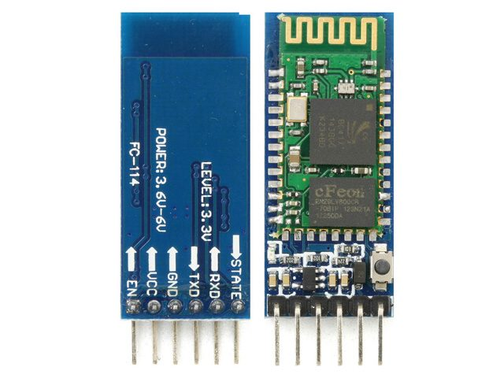
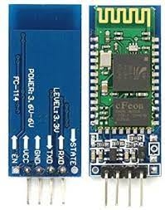
Bluetooth Module

Slide 4
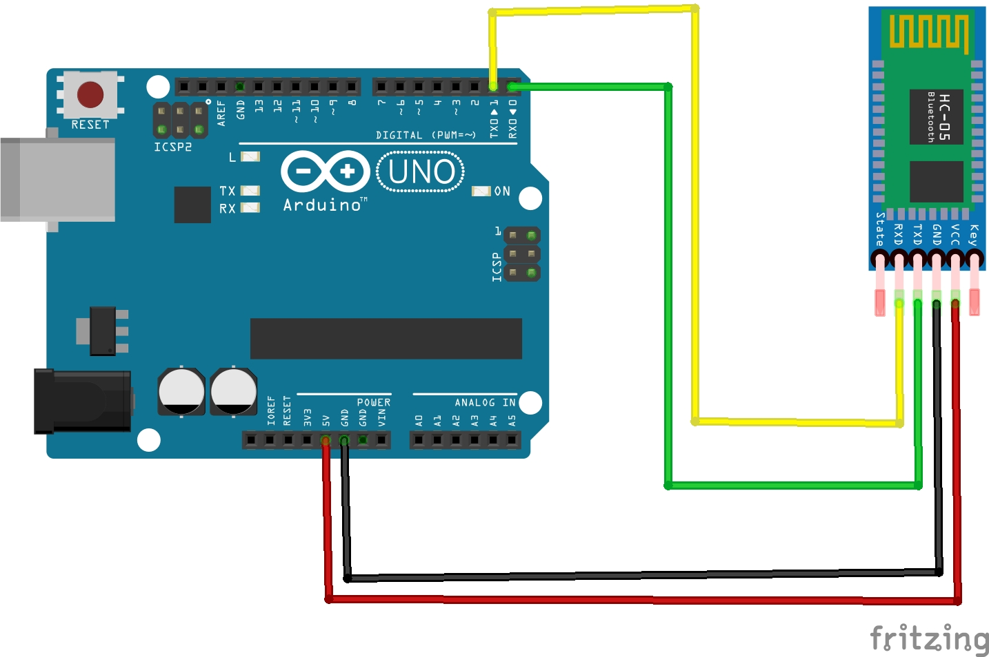
Bluetooth Module

Slide 5
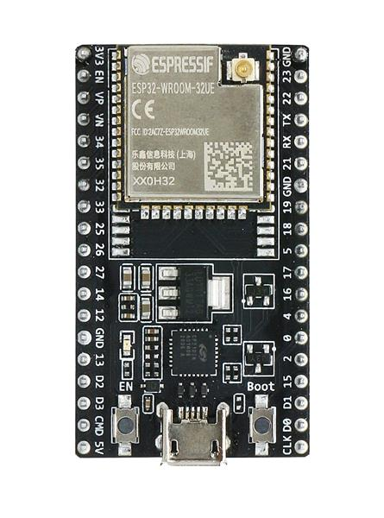
ESP32 board

Slide 6
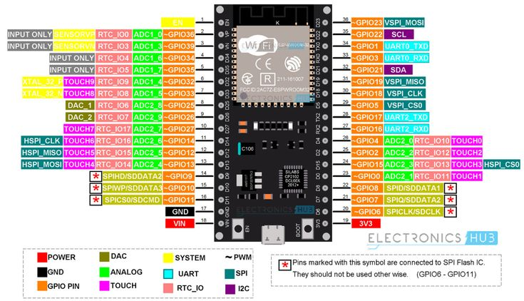
ESP32 board Pinout

Slide 7
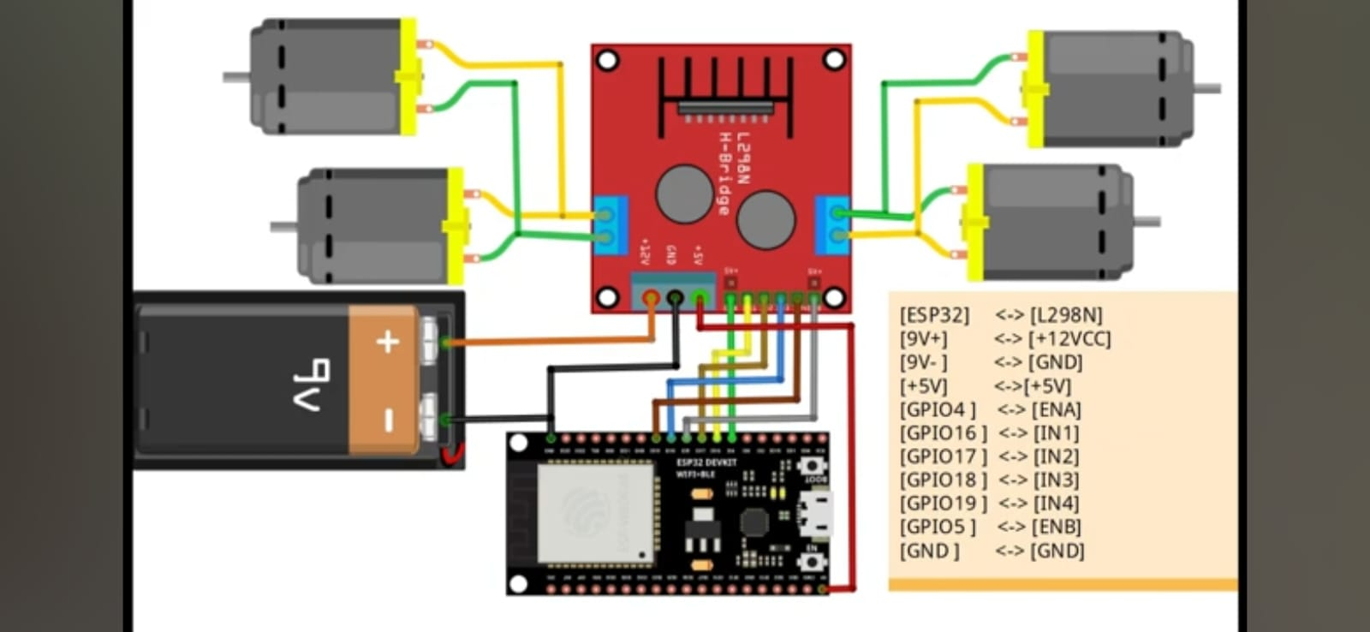
ESP32 board Connection

Slide 8
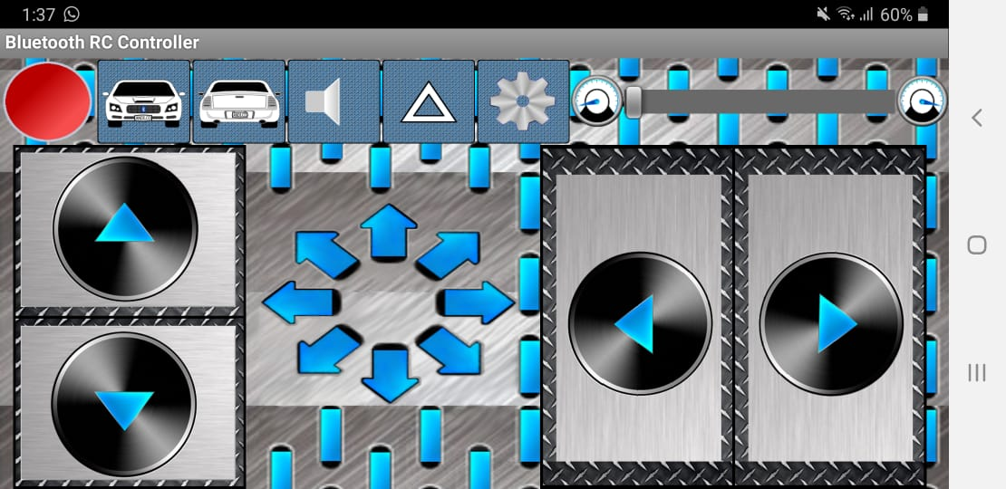
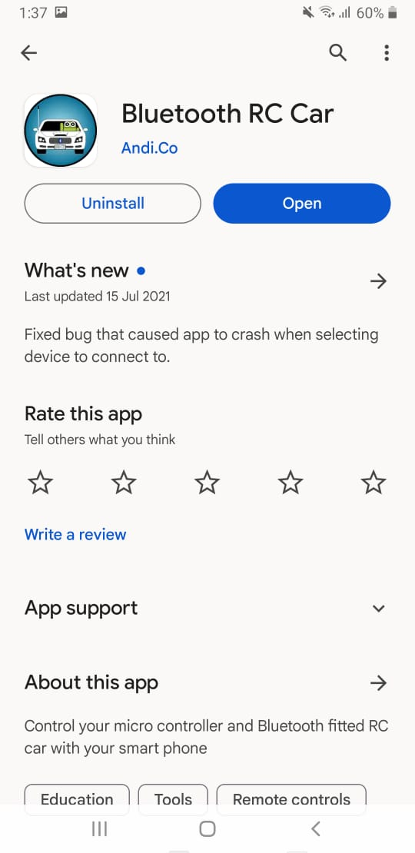
Mobile Application

Slide 9
Arduino Code

Slide 10
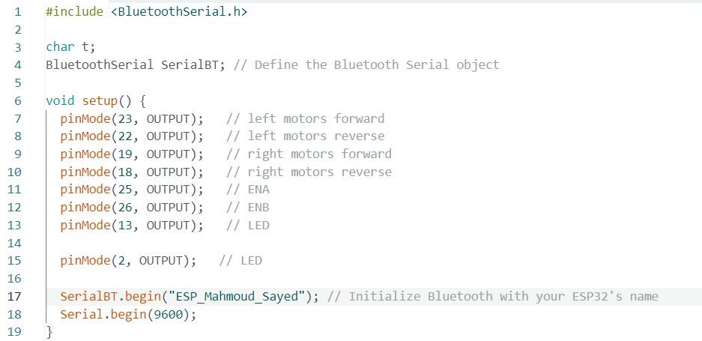
ESP32 Code

Slide 11
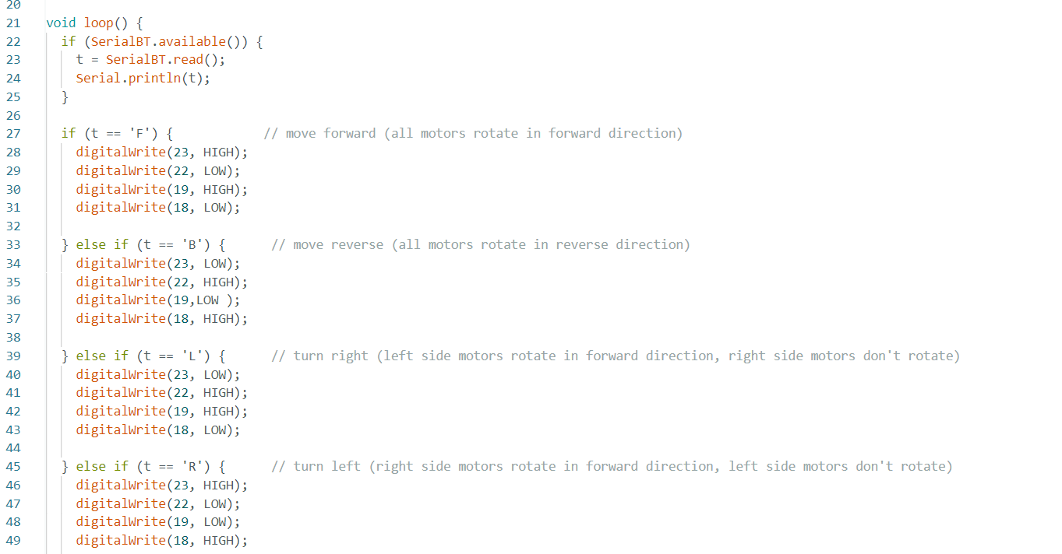
ESP32 Code

Slide 12
Thanks!

